Slide 1
Understanding and evaluating large language models
Matthew Engelhard

Slide 2

How to evaluate generative LLMs is very much a work in progress
Additional open questions include:
Can we trust models to evaluate other models?
How can models learn when to defer to human experts?
How can we identify LLM biases?
Notes:
Ask the group – how would you evaluate a generative model?
What approaches have you seen?

Slide 3
What are LLMs, and why do they hallucinate?
(after first breakout)

Slide 4

LLMs are initially trained to predict the next word
y, next word
x, conversation history
End goal: predict y from x
Notes:
Now, what about the systems we’re seeing today?
Does the paradigm I’ve described still fit?

Slide 5
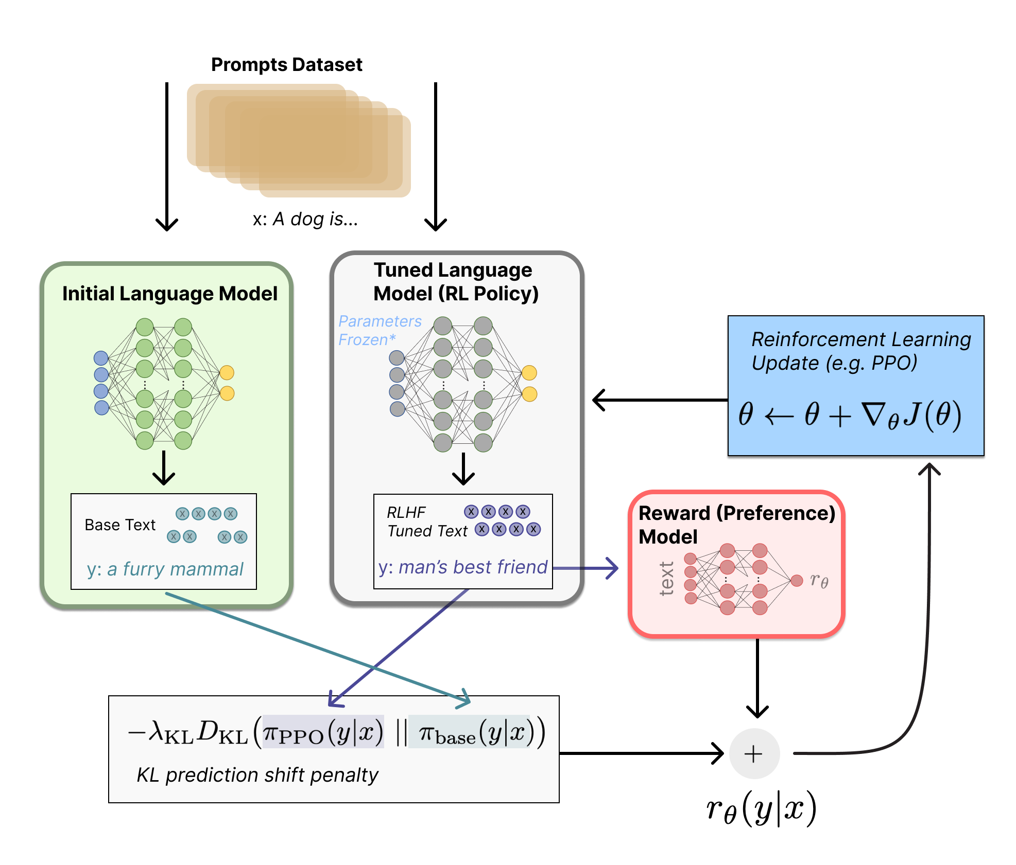
They’re then fine-tuned to match our preferences
Step 1: Train an auxiliary preference model (via human feedback) to assign scores to LLM-generated text that are consistent with our preferences
Step 2: Fine-tune the initial LLM (via reinforcement learning) to achieve better scores, implying better alignment with our preferences
Illustrating Reinforcement Learning from Human Feedback (RLHF)
https://huggingface.co/blog/rlhf

Slide 6
LLM training does not ensure content is accurate
LLM knowledge and beliefs derive from:
their initial training data
the people who train the reward model used to fine-tune
None of this ensures that content is accurate.
We do prefer accurate content to some degree, but we also prefer responses that are agreeable, helpful, and confirm our biases.
It is not clear how we might ensure accuracy at scale.

Slide 7
What is RAG, and why can results be misleading?
(after second breakout)

Slide 8
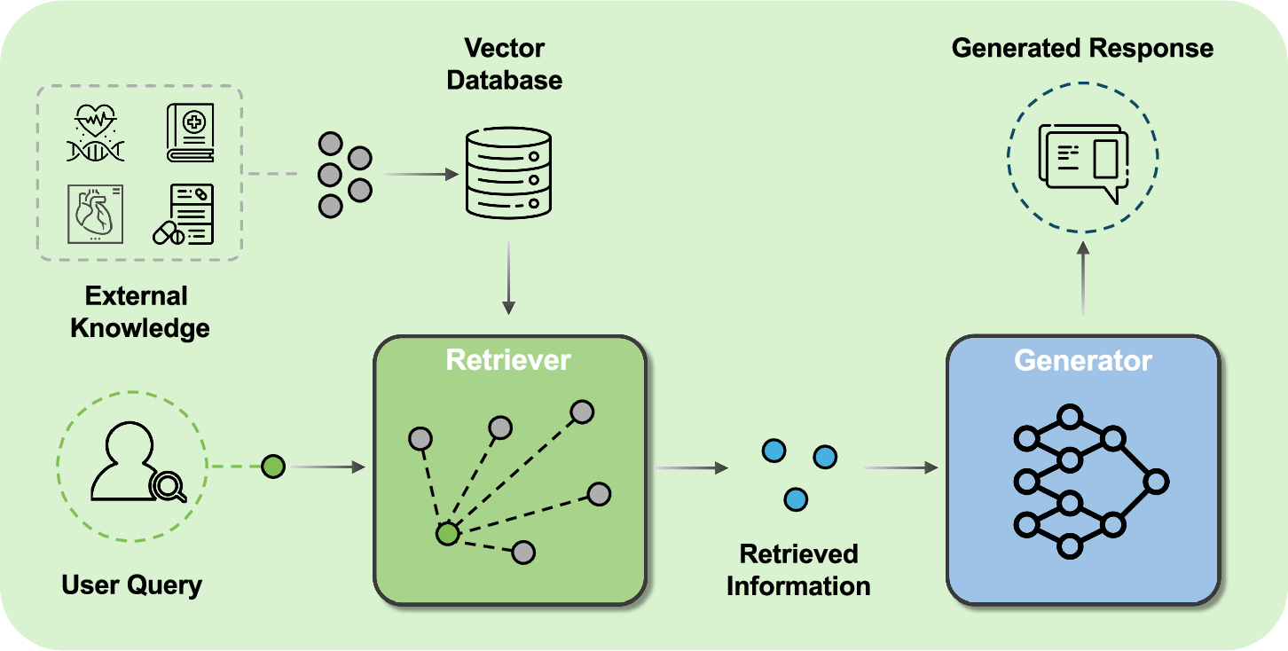
RAG augments LLMs with external knowledge
Yang, R., Ning, Y., Keppo, E. et al. Retrieval-augmented generation for generative artificial intelligence in health care. npj Health Syst. 2, 2 (2025).

Slide 9
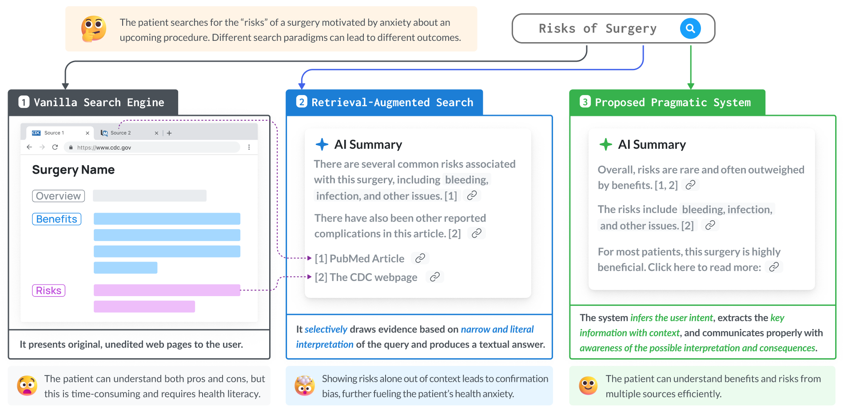
RAG is biased toward supporting the query
Position: Retrieval-augmented systems can be dangerous medical communicators. Lionel Wong, Ayman Ali, Raymond Xiong, Shannon Shen, Yoon Kim, Monica Agrawal. ICML, 2025.

Slide 10
A primer on LLM evaluation
Slides in this section courtesy of Monica Agrawal

Slide 11
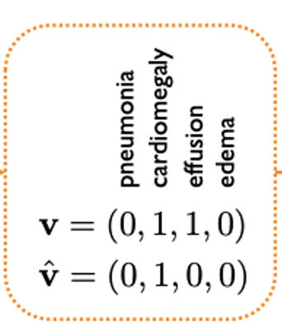

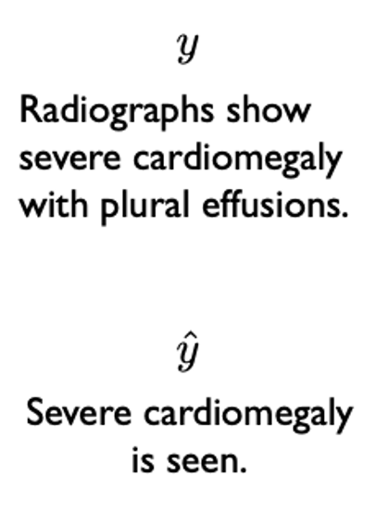
Two types of evaluation
Type #1: Intrinsic
Is the summary factual?
Does the summary miss salient points?
Does it use harmful language?
Type #2: Extrinsic
Does it improve clinicians’ ability to find salient information?
Does it accelerate their workflows?

Slide 12
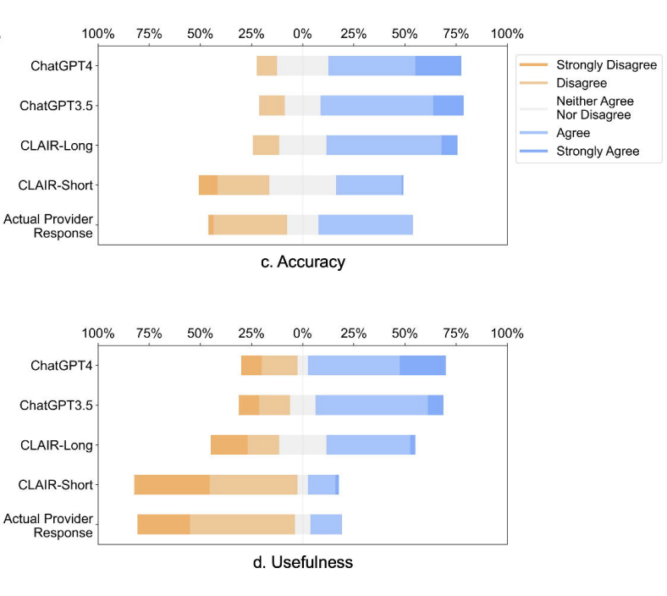
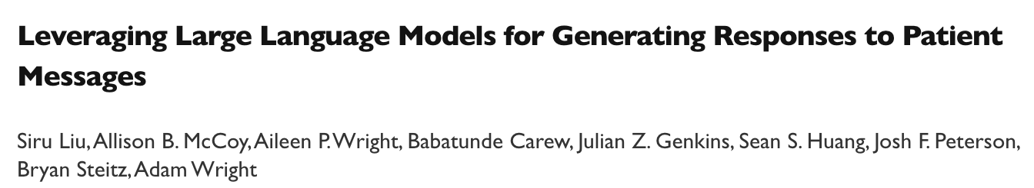
Intrinsic wins don’t always translate to extrinsic wins

Slide 13

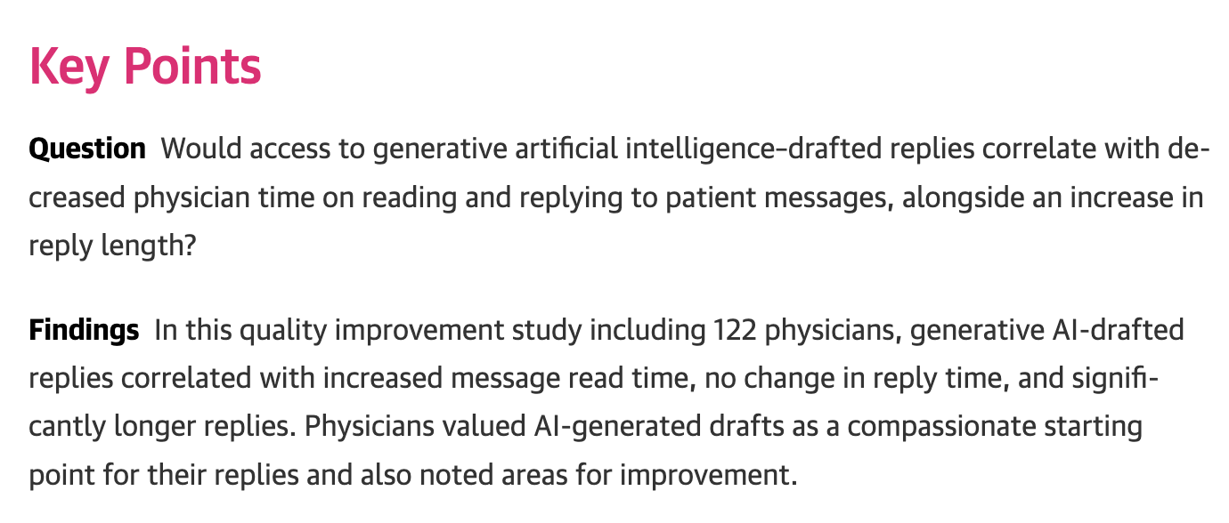
Intrinsic wins don’t always translate to extrinsic wins

Slide 14
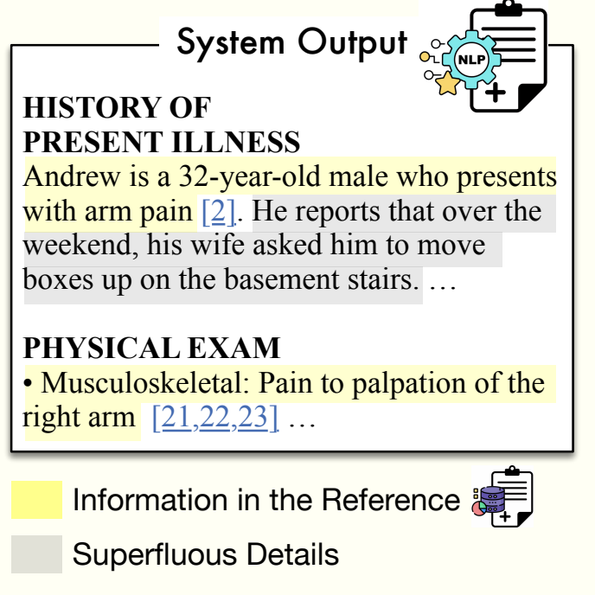
Why is evaluation hard? Reason #1.
Automated methods for evaluation rely on a reference text or a rubric:
Reference Text
A correct example corresponding to the same input (e.g. a manually written note from silent evaluation)
However, this often assumes the status quo is gold
Even with a perfect reference text, it is nontrivial to determine if the content matches up

Slide 15
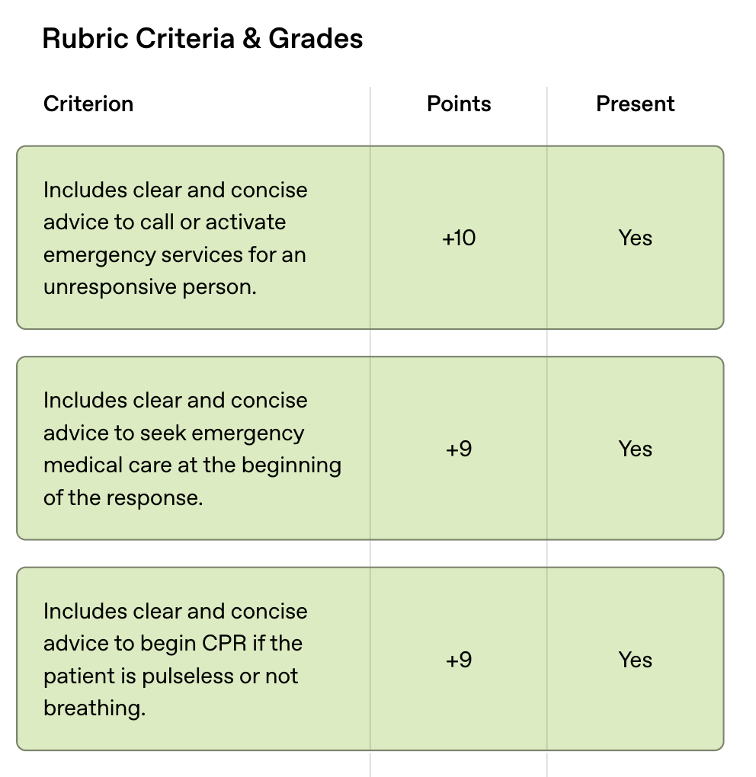
Why is evaluation hard? Reason #1.
Automated methods for evaluation rely on a reference text or a rubric:
Rubric
A set of criteria that a good response/output should have: “does the summary mention the patient’s history of X?”
Usually uses a powerful LLM to check if each criterion is met (easier than an open-ended “is this response good?”)
Time-consuming to create, not scalable to new inputs/workflows
OpenAI just released a set of 5k rubrics, in a new paper HealthBench (annotated by ~250+ doctors), focused on medical question answering specifically

Slide 16
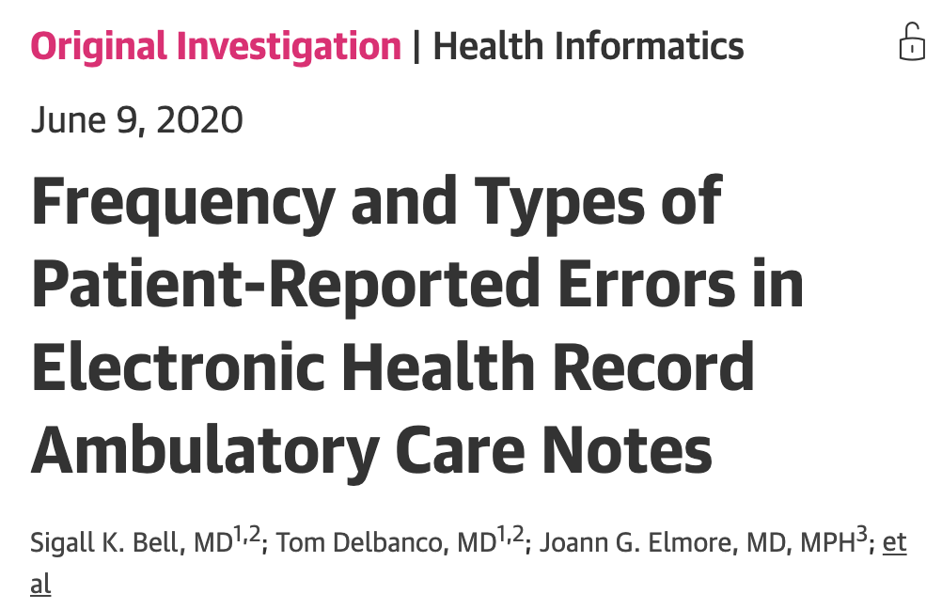
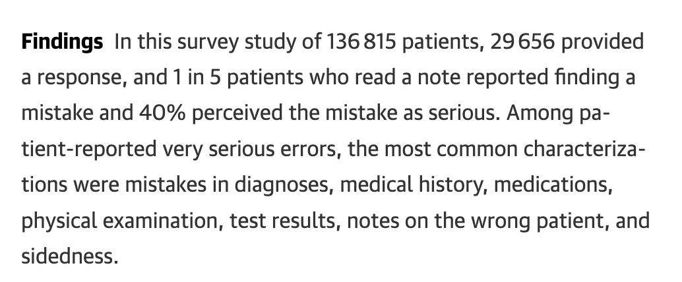
Why is evaluation hard? Reason #2.
Longer term outcome measures are uncertain and untracked
It’s hard to know how to quantify the impact of a better note/message/summary quality, outside of time and physician satisfaction
Errors prevented/induced are a difficult, untracked counterfactual

Slide 17
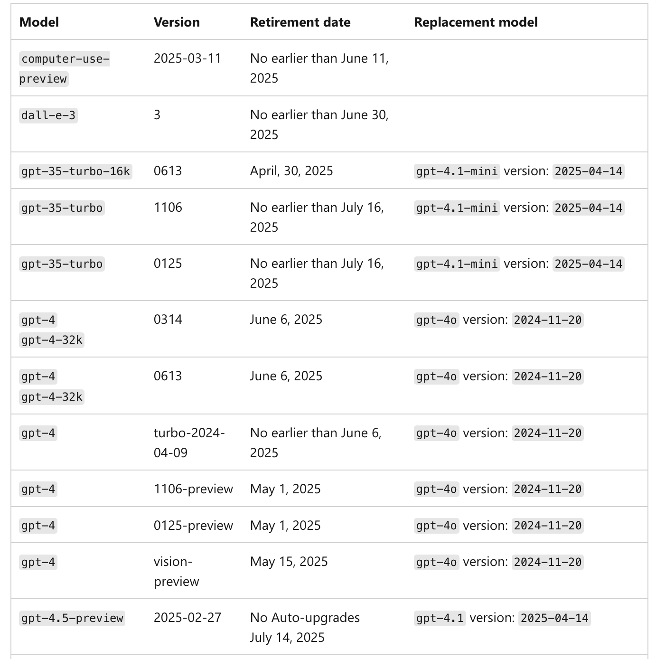
Why is evaluation hard? Reason #3.
The underlying models are constantly shifting and models are getting deprecated (see list of retired OpenAI models to the right)
Unlike with in-house predictive models, we have little control.
Evaluation has to continually occur.

